Slide 1



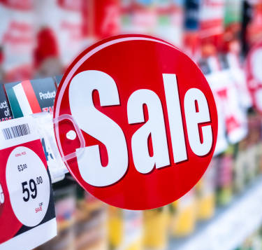

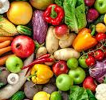
Grocery Sales Trend Analysis

Slide 2
Project Objectives
Identify popular grocery products and seasonal demand
Optimize inventory management to improve overall efficiency
Use data-driven insights to enhance profitability for grocery store owners

Slide 3
Business Questions
Which months recorded generated the most revenue?
What is the average #Items and Price per Sale?
What category is most expensive?
What cities buy discounted products the most?

Slide 4
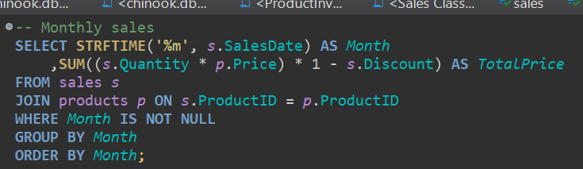
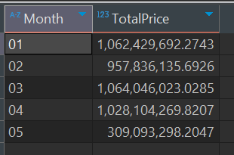
Q1: Which months recorded generated the
most revenue?
Input
Output
Interpretation:
Out of the data collected between 01/01/2018 and 05/09/2018, March made the most revenue. May made the least revenue due to only 9 days of the month recorded.

Slide 5
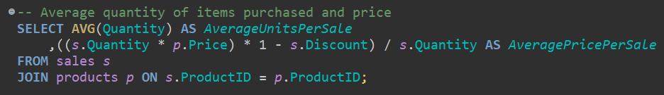
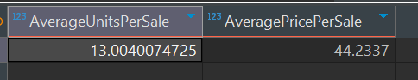
Q2: What is the average #Items and Price per Sale?
Input
Interpretation:
On average, a customer has 13 items in their cart. With an average of $44.23 per cart.
Output

Slide 6
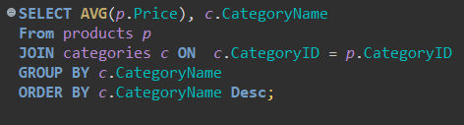
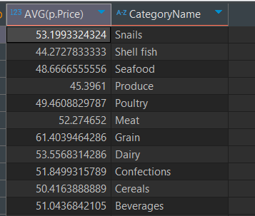
Q3: What category is most expensive?
Interpretation:
Snail, Shell Fish and Seafood are the most expensive catagories.
Input
Output

Slide 7
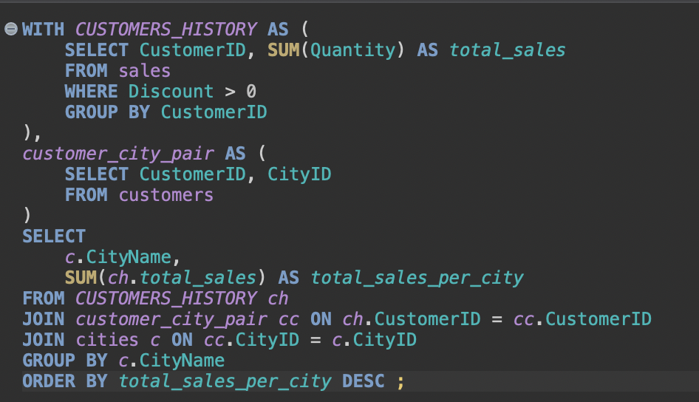
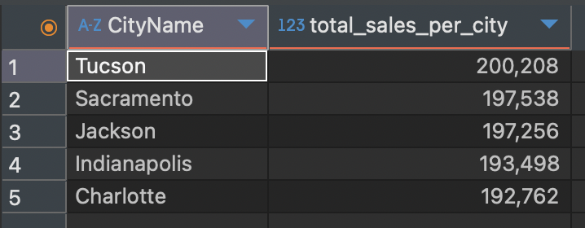
Q4: What cities buy the most discounted products?
Interpretation:
Cities whose average income is below or at par with the state’s average income tend to buy more discounted products.
Input
Output

Slide 8
Business Recommendations
Stock up inventory in February; hire temp staff in March for peak Q1 sales.
Ensure ample shopping carts and cashiers as customers usually shop in buk
Prioritize affordable products in low-income cities. Sell sea food products in higher income areas.

